Slide 1
CS457
FINAL PRESENTATION
TEAM PERRY
Nabila Sindi Wulandari 20180744
Mohamed Almaazmi 20170850
Chrysan Angela Piarso 20180949

Slide 2
TABLE OF CONTENTS
01
TEAM MEMBERS & ROLES
02
MAIN OBJECTIVES
03
REQUIREMENTS ELICITATION ACTIVITIES
04
CONTEXTUAL DESIGN RESULTS
05
CORE REQUIREMENTS
06
PROTOTYPE
07
LESSONS LEARNED

Slide 3
TEAM MEMBERS & ROLES

Slide 4
Team Members & Roles
Nabila
Application Design
Prototype Design and simulation
Artifact and Consolidating Artifact Model
Interface and Purchased Materials Section
Purpose Section
Storyboards
Vision Diagram
Mohamed
Scope
Assumptions and Dependencies
Use case model survey
Domain model
Actor model survey
Requirements analysis
Functional
Non-functional
Constraints
Chrysan
Flow and Consolidating Flow Diagram
Sequence and Consolidating Sequence Diagram
Cultural and Consolidating Cultural Diagram
Physical and Consolidating Physical Diagram
Lessons Learned (PPT)
Affinity Diagram

Slide 5
MAIN OBJECTIVES

Slide 6
Main Objectives of Our System:
A smart kitchen to help users:
Reduce the risk of accidents in the kitchen
Help manage the kitchen, from food to electricity, at home through a single, central application.
The application will be web-based, offering customizable functionalities that will let users display information data remotely.

Slide 7
REQUIREMENTS ELICITATION ACTIVITIES
Notes:
Now we’re going to talk about the requirements elicitation methods and processes

Slide 8
Methods Used:
Online Interview (Main)
We scheduled an appointment with each participant and asked them a set of questions. Interviews were done through Zoom.
Questionnaire
This method is used if it is difficult to schedule an appointment with an interviewee. We sent a link to a Google Form to a participant and asked them to answer our questions.
Affinity Diagram
We used Miro as a platform to discover connections among our interview and questionnaire findings.
Scenario and Storyboarding
We selected three most important scenarios from our findings and made a storyboard for each one of them.
Notes:
These are the methods that we used for requirements elicitation. Our main method is online interview, which is done on Zoom. We interview For almost all of the interviews, we had one observer and one interviewer.

Slide 9








Finding Potential Participants
Asking friends and friends of friends
Using group chats and social media
Notes:
We find potential participants by asking ..

Slide 10
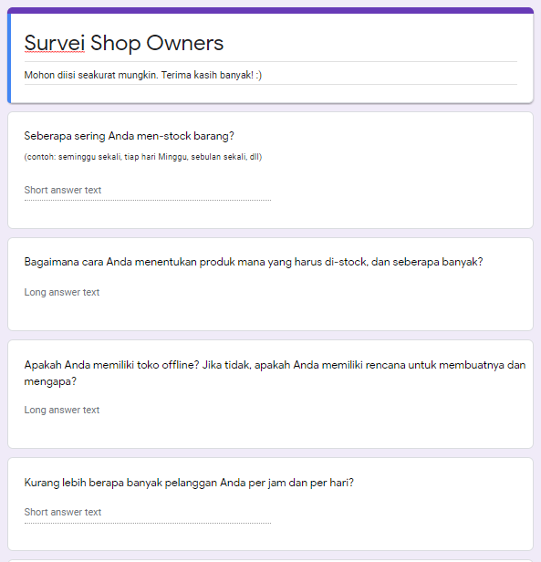
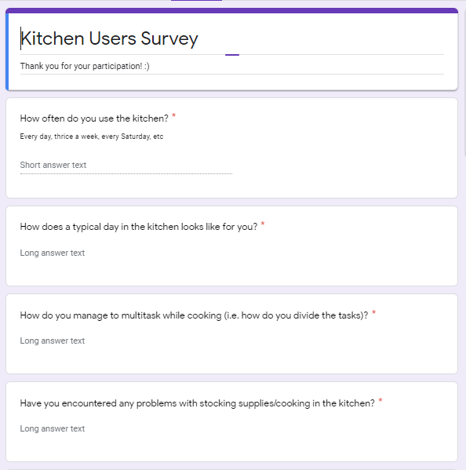
Questionnaire Snippets
Notes:
And here’s some snippets of our questionnaires

Slide 11
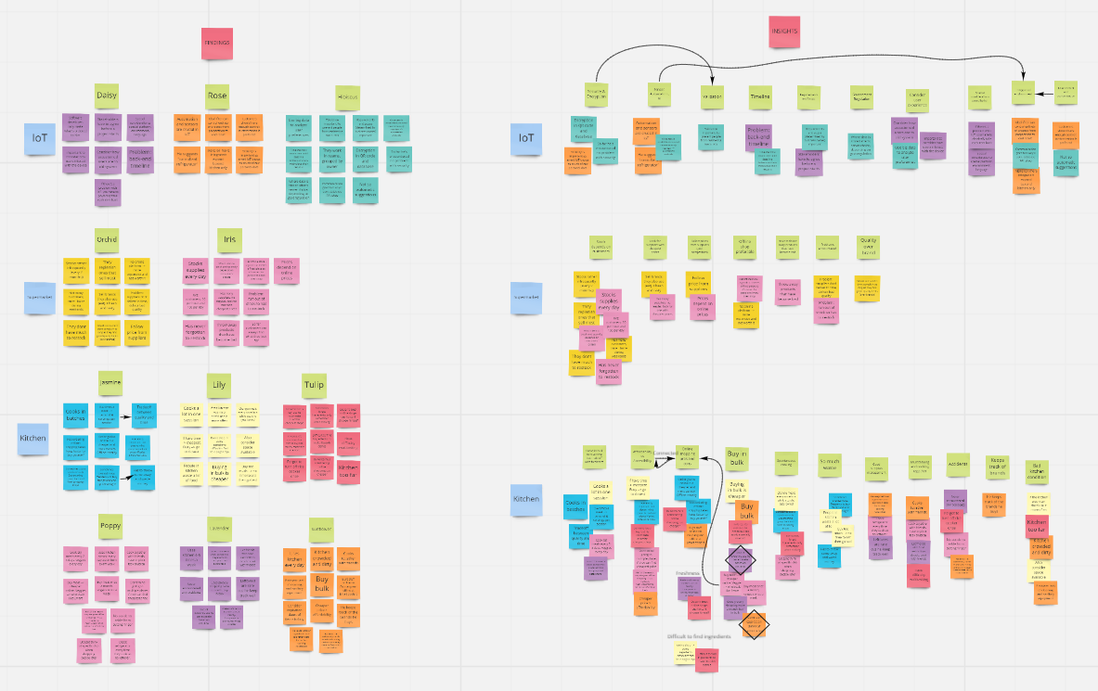
Affinity Diagram
Notes:
And affinity diagram
Make online post its for each participant on the left, and then we categorize them according to similarity in ideas on the right.

Slide 12
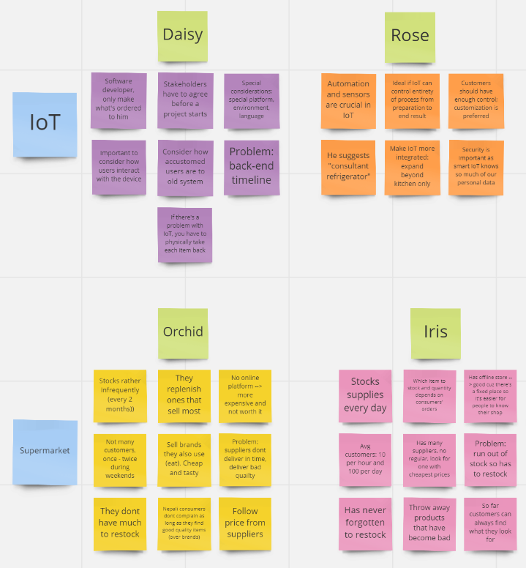
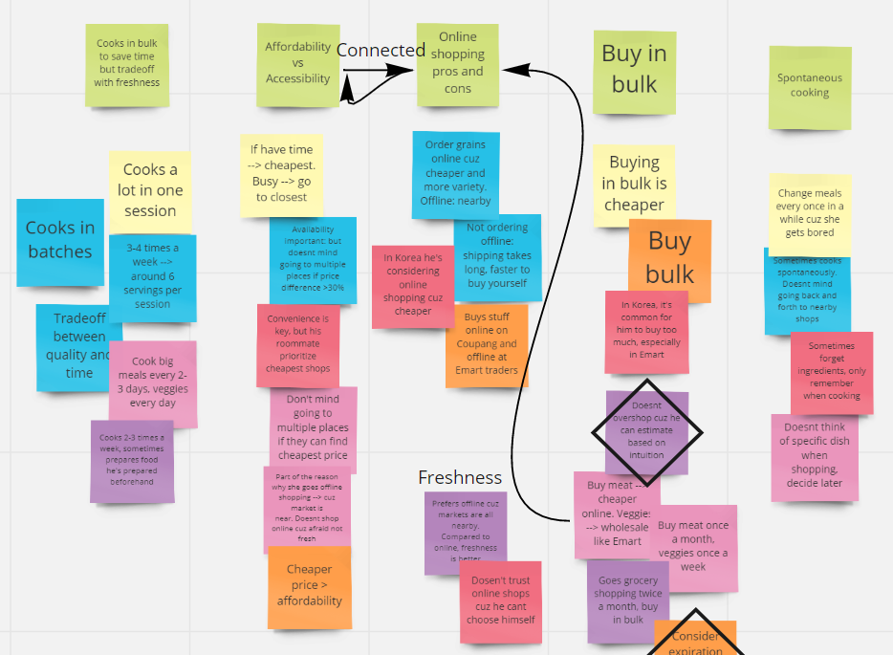
Affinity Diagram Snippets

Slide 13
Scenarios & Storyboards
Through discussion, we have prepared three visionary scenarios that are potential examples of interaction sessions.
With each scenario, we created a passive storyboard to visualize those scenarios and how it would blend in real-life situations that our stakeholders might be involved in.
Notes:
From previous requirements elicitation results, we came up with three visionary scenarios.

Slide 14
Scenario #1: View Kitchen Data (Electricity Consumption)
Initial Assumption | Sensor Based for Physical Things is turned on and connected to Cloud Server. User is connected to Wi-fi and is logged in to the System.
Normal | Sensors take measurements and push data to Cloud server via Wi-fi. User opens their dashboard and is given the kitchen appliances stats, such as energy consumption, its on/off state, and many more. User can choose to interact with the kitchen appliance through the dashboard.
What Can Go Wrong | Wi-fi might not be connected -> Prompt user to check W-fi connection. User is not logged in -> Prompt user to log in. Error in measurements. Ex: Measurements of two nearby sensors vary extremely. -> Prompt Owner to check for the malfunctioning of the sensor.
Other Activities | Sensors take measurements and constantly update the data on the dashboard.
System State on Completion | Collection of data from the sensors is pushed to Cloud and the User was able to see the data on the dashboard.
Notes:
First one is viewing kitchen data

Slide 15
Scenario #2: Plan Grocery List
Initial Assumption | Sensor Based for Physical Things is turned on and connected to Cloud Server. User is connected to Wi-fi and is logged in to the System.
Normal | Sensors take measurements and push data to Cloud server via Wi-fi. The User can open their dashboard and choose list of items menu. The User can use the list to plan a grocery list.
What Can Go Wrong | Wi-fi might not be connected -> Prompt user to check W-fi connection. User is not logged in -> Prompt user to log in. The System does not generate the list of items -> Prompt user to restart the system.
Other Activities | Sensors constantly push the changing data to the Cloud.
System State on Completion | User successfully used system to plan their grocery list.

Slide 16
Scenario #3: View Statistics on What items Homeowners Buy
Initial Assumption | The Supermarket owner is connected to Wi-fi and is logged in to the System.
Normal | The Supermarket owner opens their dashboard. The Supermarket owner chooses the menu to view statistics on what items homeowners buy.
What Can Go Wrong | Wi-fi might not be connected -> Prompt user to check W-fi connection. User is not logged in -> Prompt user to log in.
Other Activities | Sensors in home owners’s houses push data to the Cloud, updating the database.
System State on Completion | The Supermarket owner successfully viewed statistics on what items homeowners buy and may choose to create decisions based on that.

Slide 17
CONTEXTUAL DESIGN RESULTS
Notes:
After midterms, we also did contextual design. Here are our results.

Slide 18
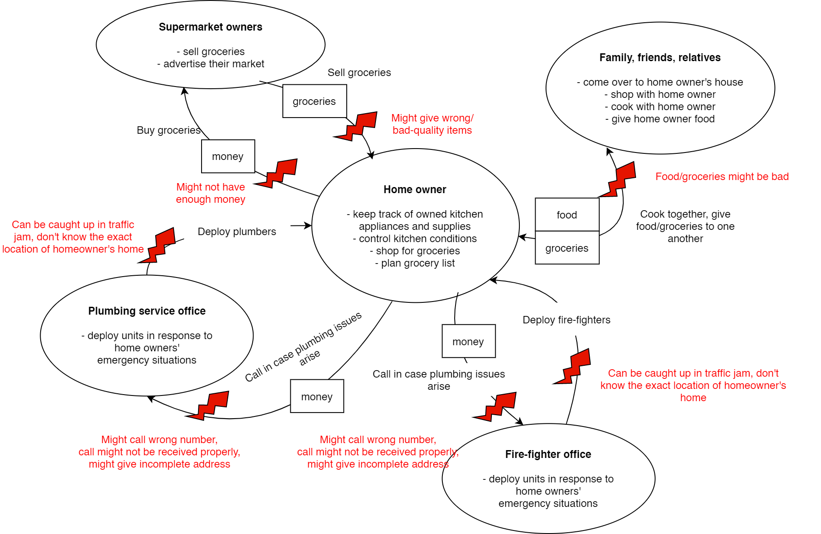
Flow Model
Notes:
Here’s our flow model. Each homeowner interacts with supermarket owners, family, friends, and relatives, plumbing service office, and fire-figther office.

Slide 19
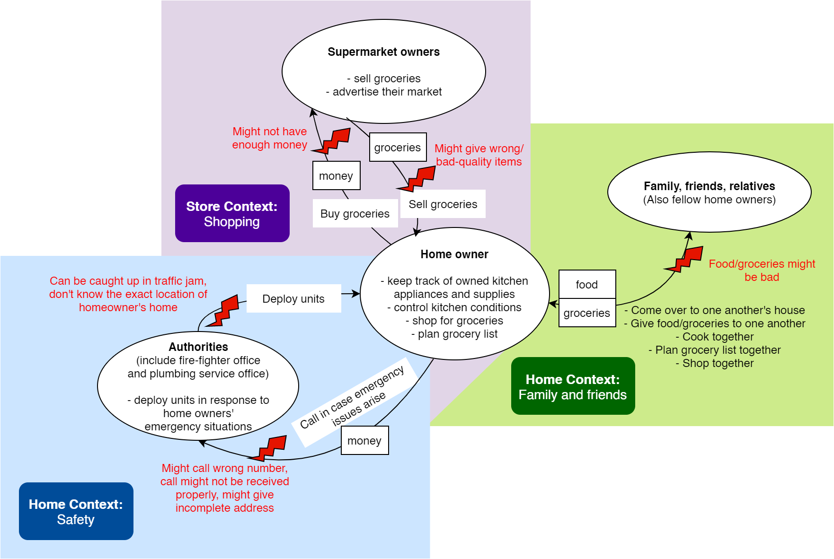
Consolidated Flow Model
Notes:
Based on the flow model in the previous slide, we came up with this consolidated flow model. There are three common contexts: keeping home hygiene and security, interacting with fellow homeowners, and shopping.
From this diagram, we noticed that actors are prone to human error. Guests might mistakenly give bad-quality food or groceries; fire-fighters or plumbers might get caught up in traffic jam; and home owners might accidentally buy wrong items or forget to bring enough money.

Slide 20
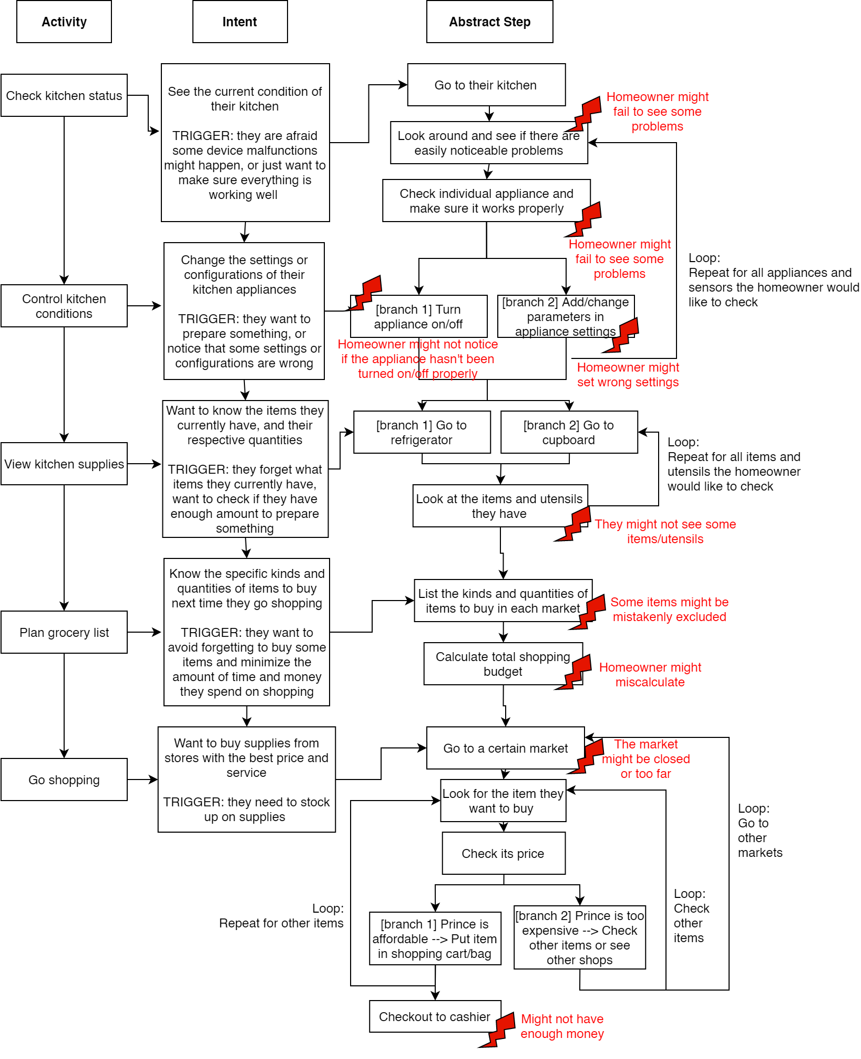
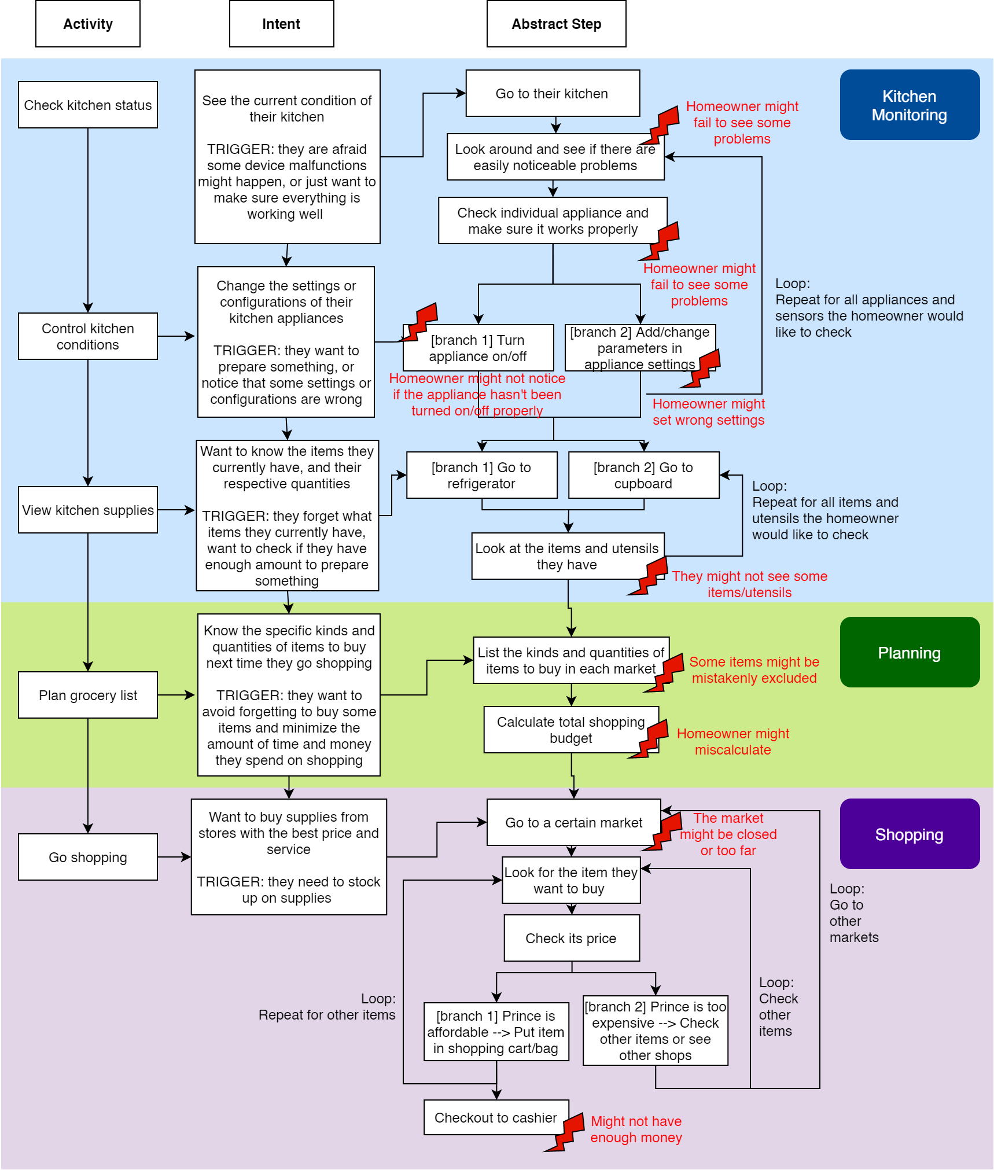
Sequence Model
Consolidated Sequence Model
Notes:
And here’s our sequence model and its consolidated form. We categorized users’ activities into three main categories: kitchen monitoring, planning, and shopping. We also realized human error mistakes in this model. Home owners might fail to see problems, some of which can be dangerous. They might also forget to include some items in their grocery list or forget to buy some items in markets. They could also calculate the total cost of their groceries in grocery list wrongly, causing them to not have enough money when they’re about to pay.

Slide 21
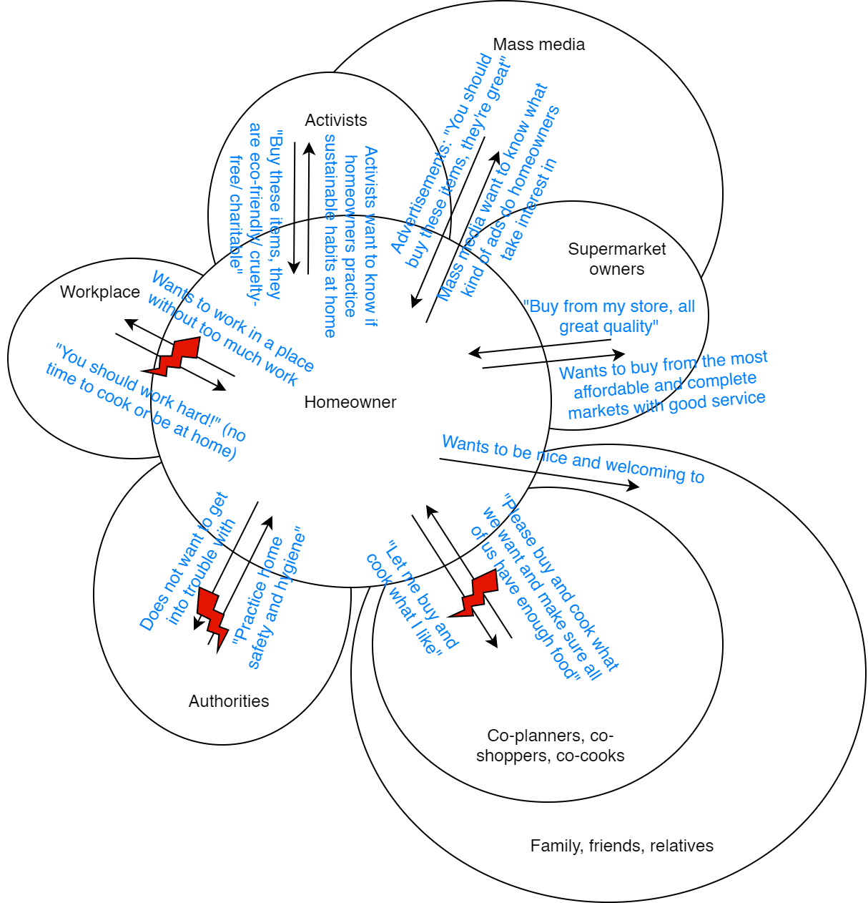
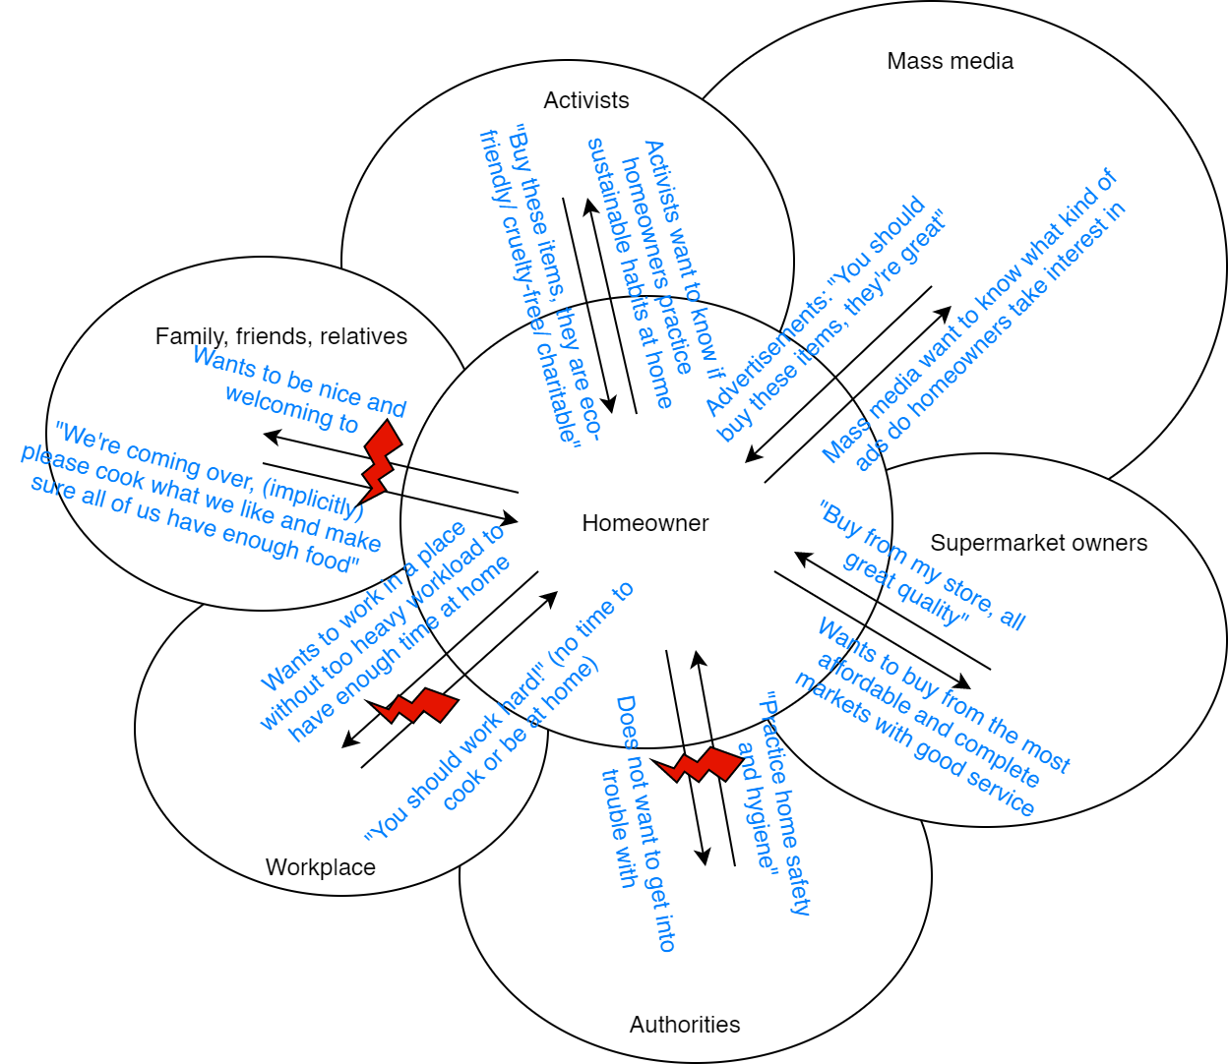
Cultural Model
Consolidated Cultural Model
Notes:
Here’s our cultural models. We found out that home owners are influenced by their workplace, authorities, family, friends, relatives, and mass media, which itself is influenced by activists and supermarket owners. Activists try to advertise eco-friendly, cruelty-free, or other charitable products; while supermarket owners will advertise that their stores are the best. Homeowners try to obey authorities and manage their work/life balance. They might also get into disagreements with their family, friends, and relatives, because they might want homeowners to cook something they dont like or cook too much.

Slide 22
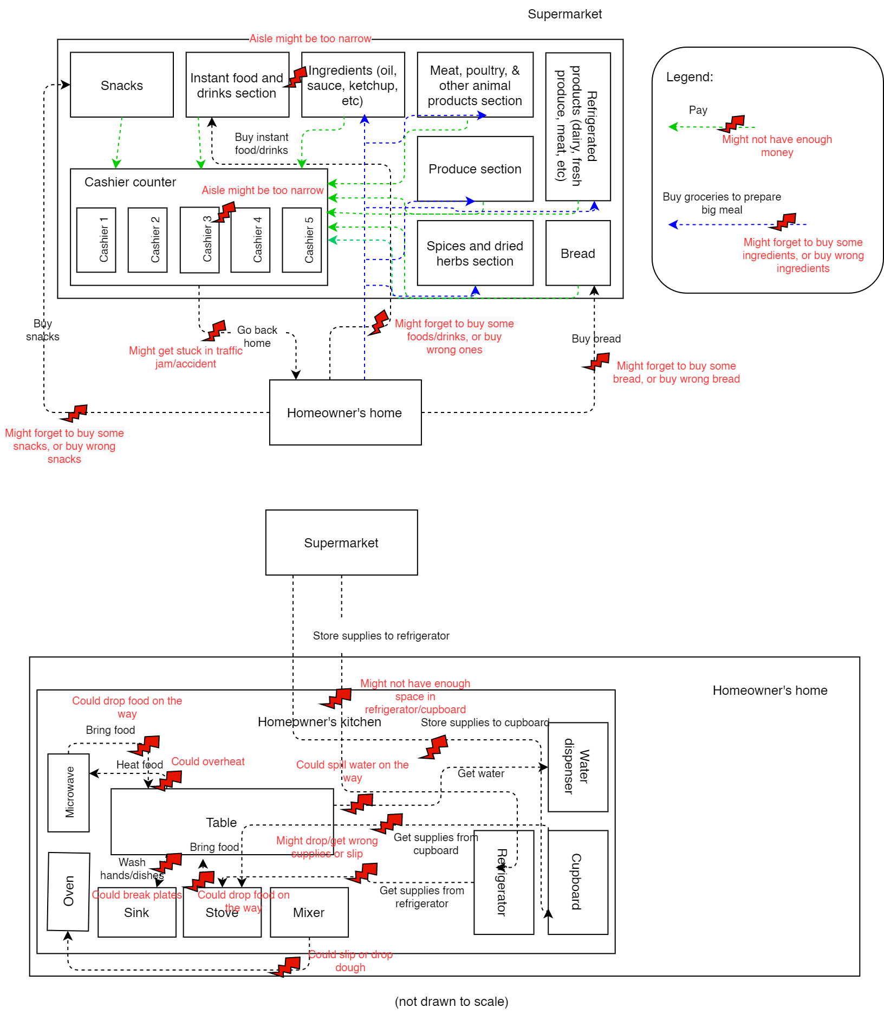
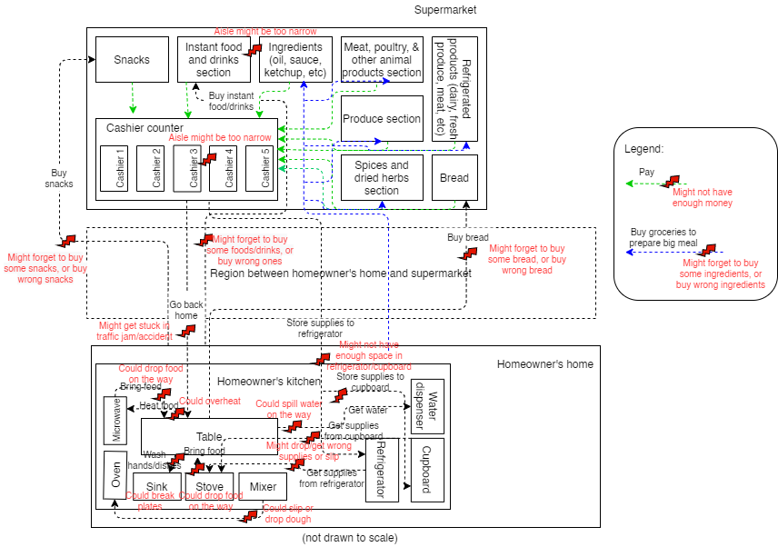
Physical Model
Consolidated Physical Model
Notes:
Here’s our physical models. We discovered that a lot of problems could arise as a consequence of the layouts of homeowners’ house and the supermarkets. They might slip, causing them to drop food, groceries, or drinks. If the aisles are too narrow, they might find it difficult to move around. At home, they might also overheat their food or break some plates. In addition to that, homeowners might also face similar problems to those discovered in previous models, such as forgetting to bring enough money, forgetting to buy some items, and caught up in traffic jam.

Slide 23
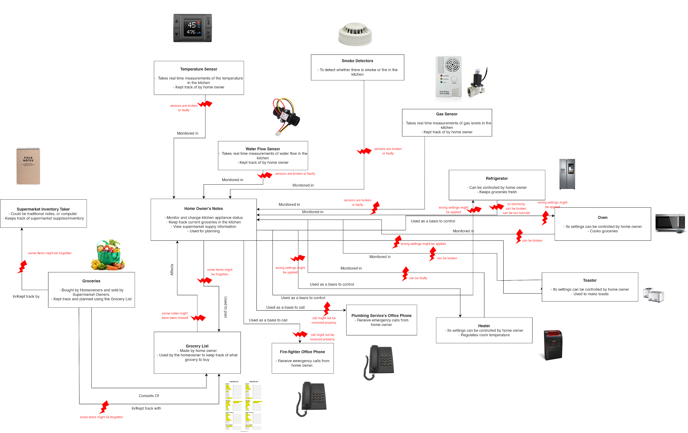
Artifact Model

Slide 24
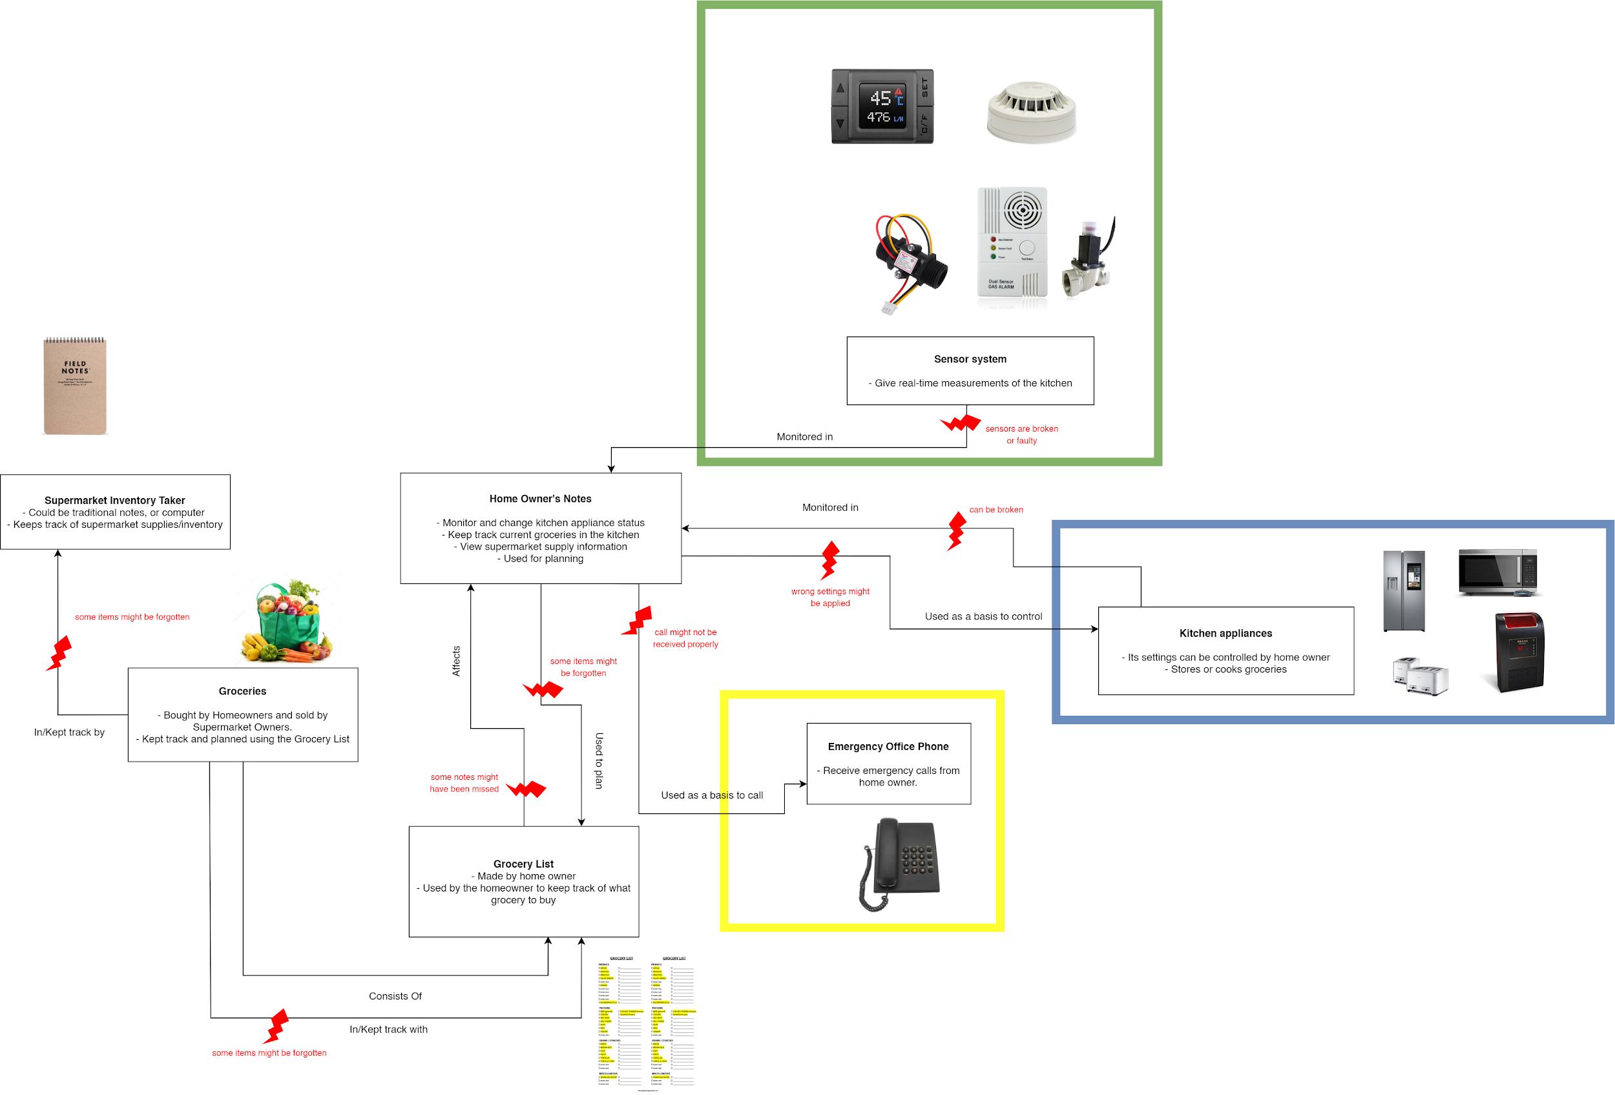
Consolidated Artifact Model

Slide 25
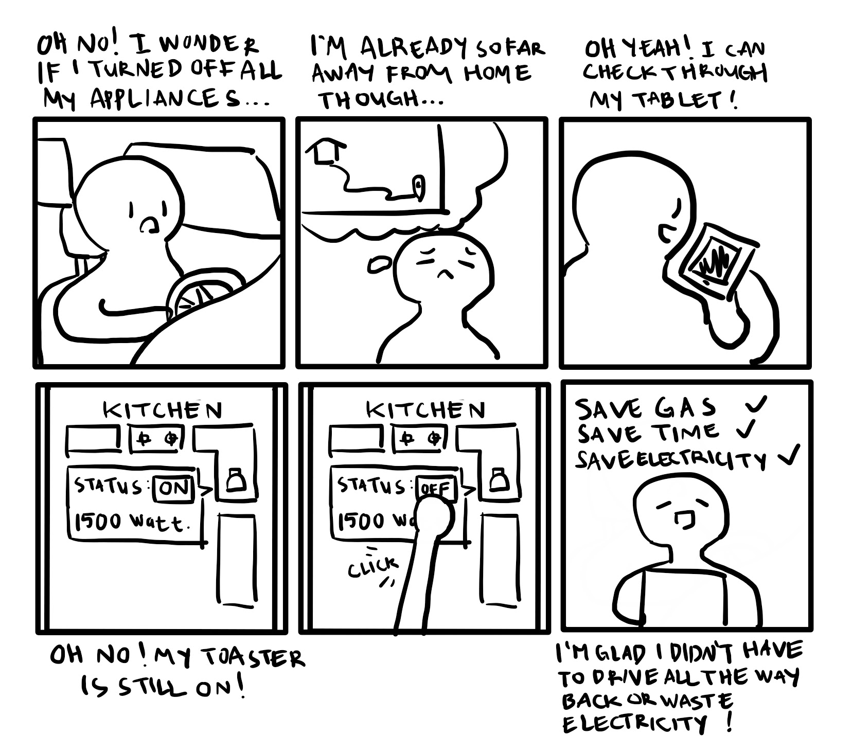
Storyboard #1
(Relating to
Scenario 1#)

Slide 26
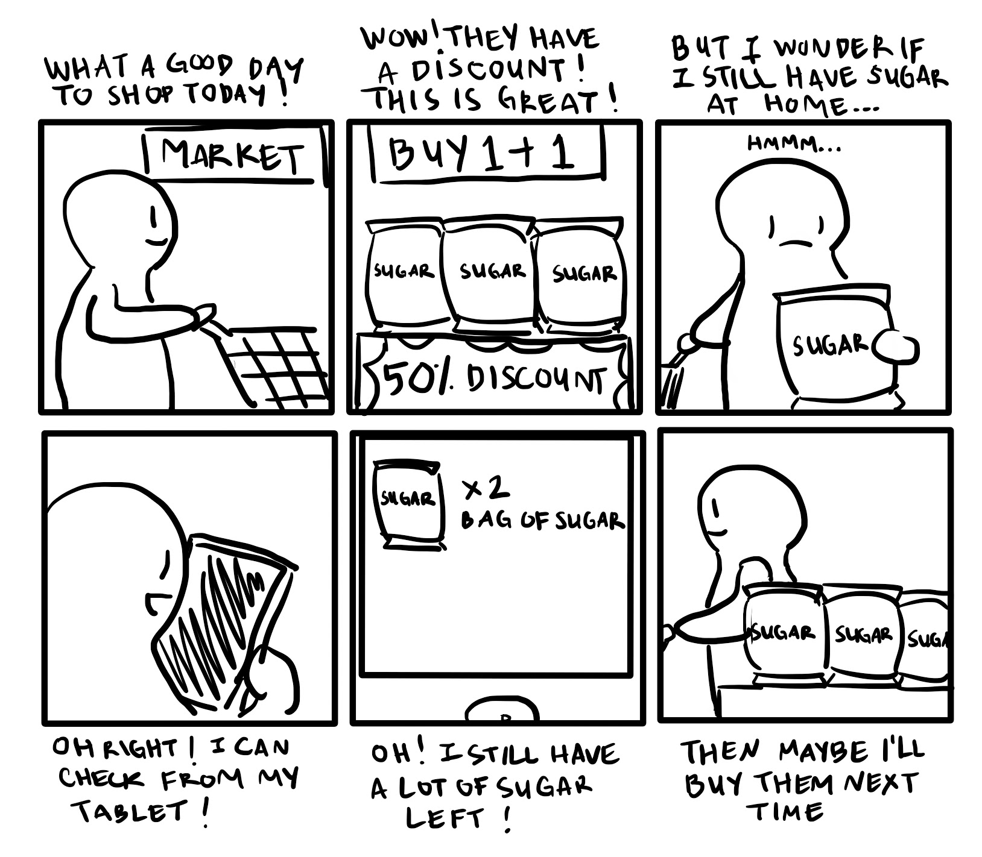
Storyboard #2
(Relating to
Scenario #2)

Slide 27
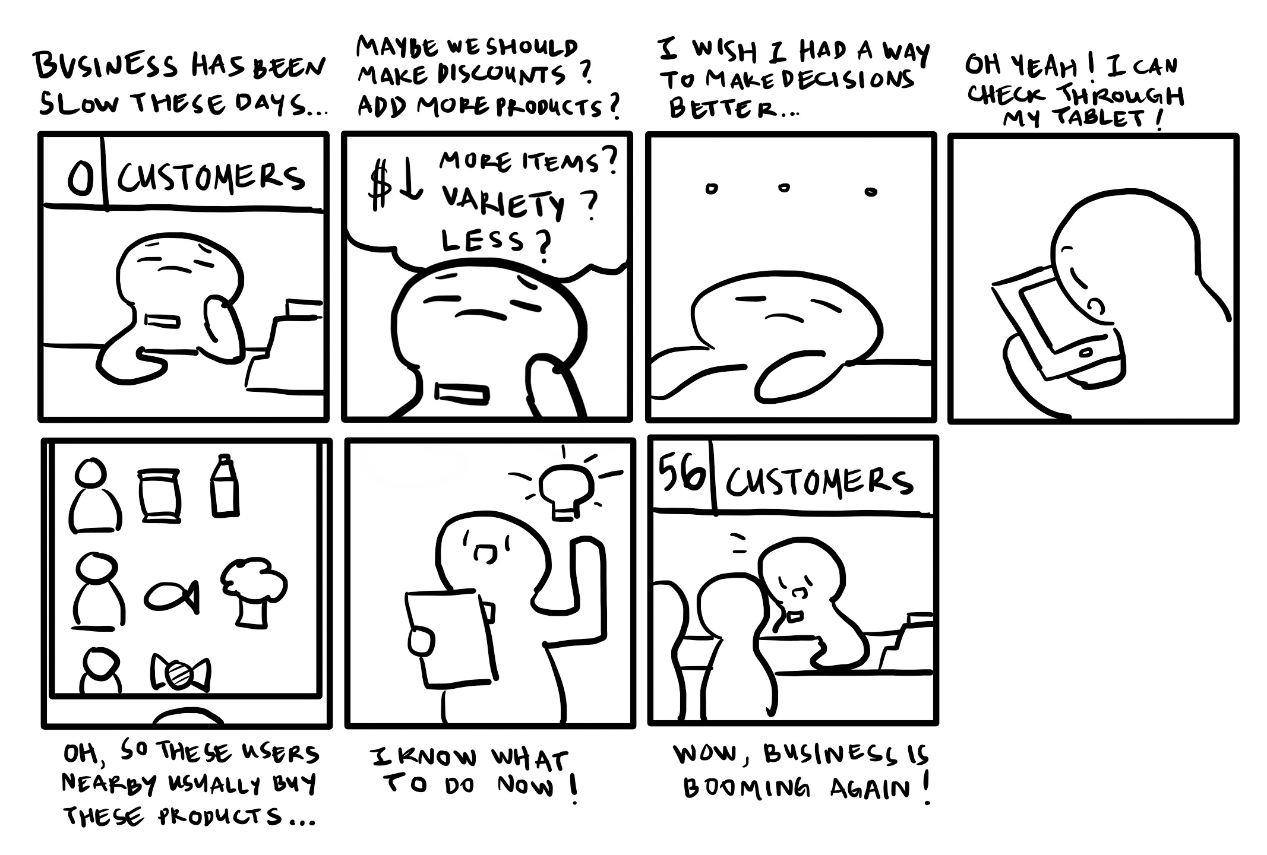
Storyboard
#3
(Relating to
Scenario #3)

Slide 28
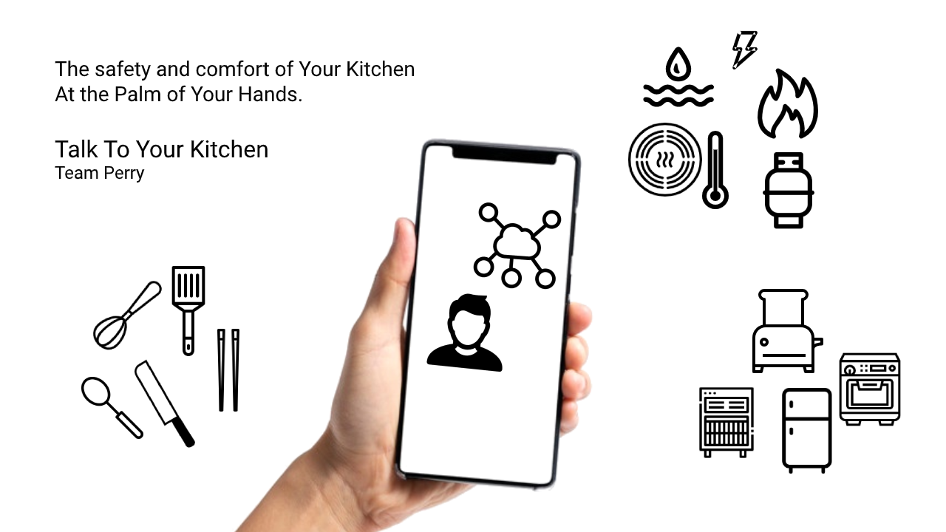
Vision Diagram

Slide 29
User Environment Design

Slide 30
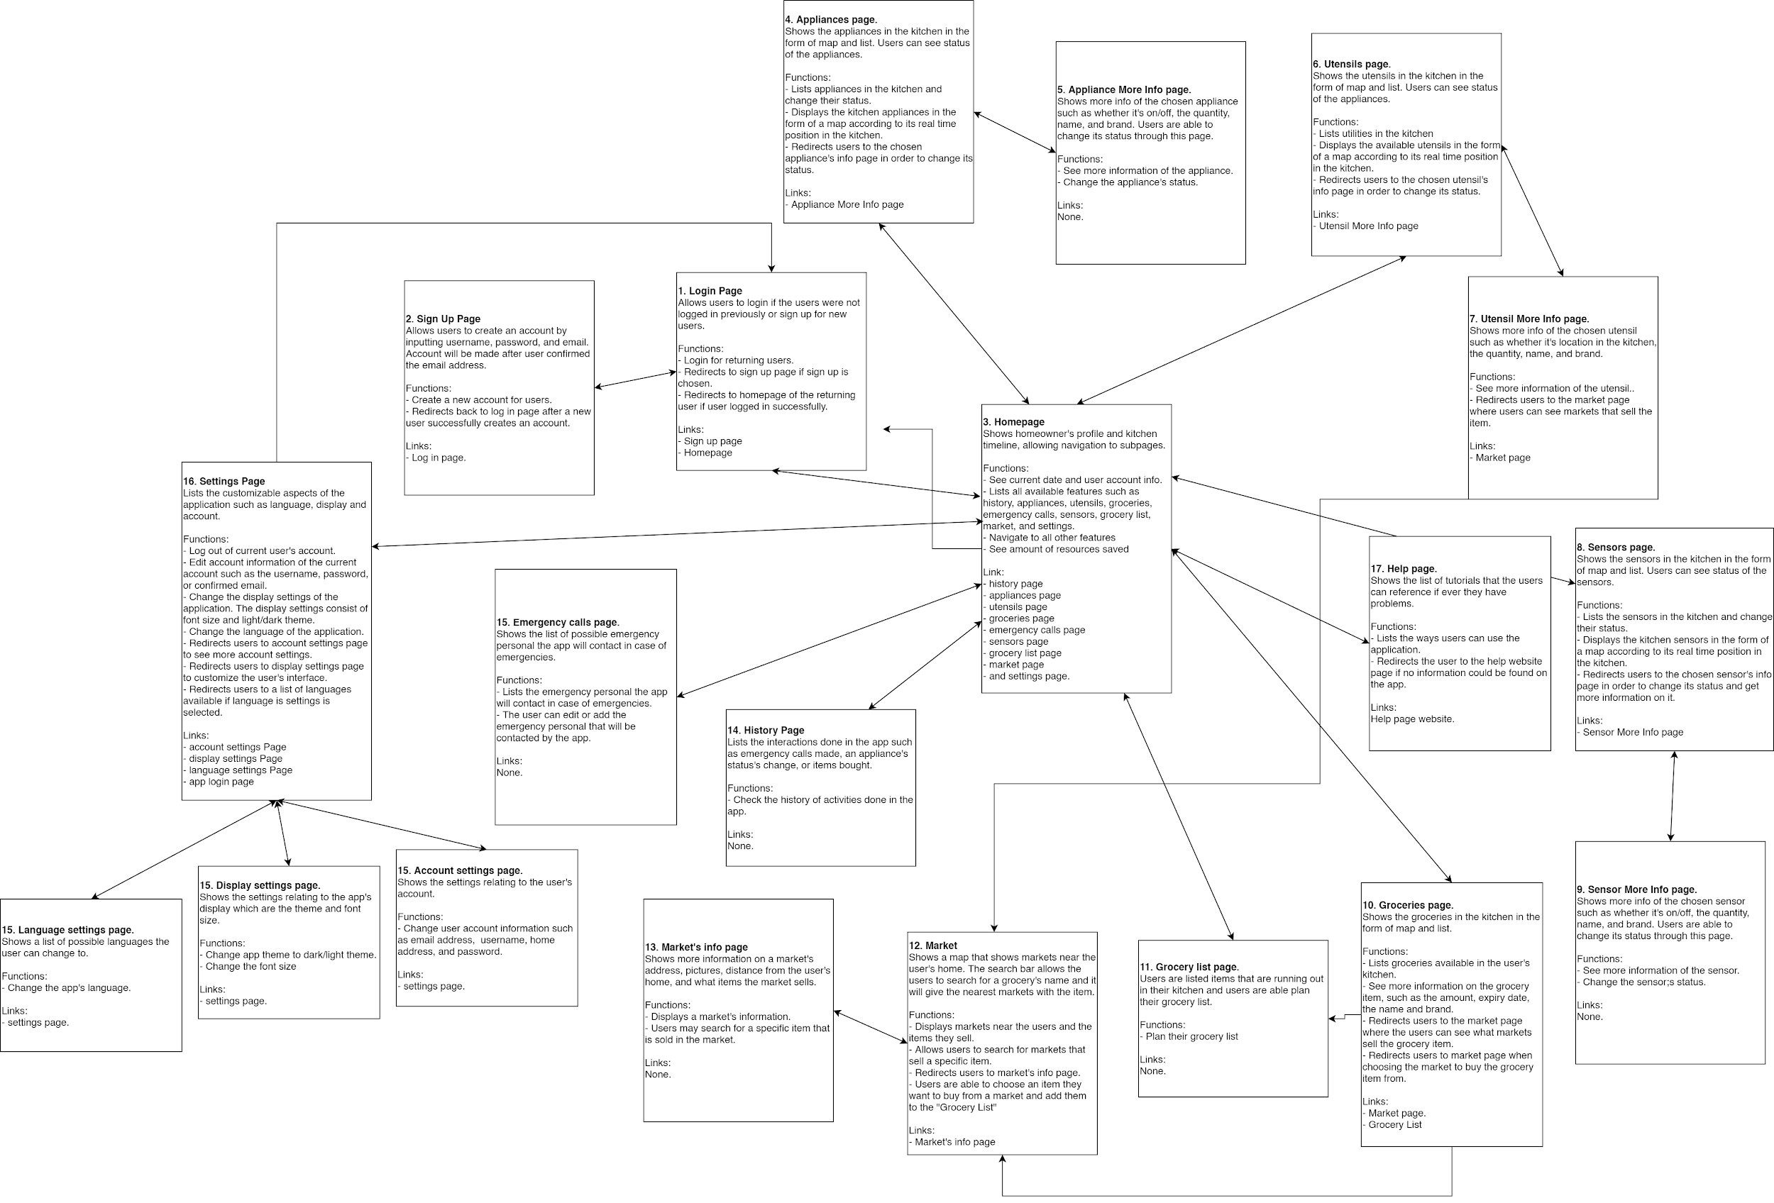

Slide 31
CORE REQUIREMENTS

Slide 32
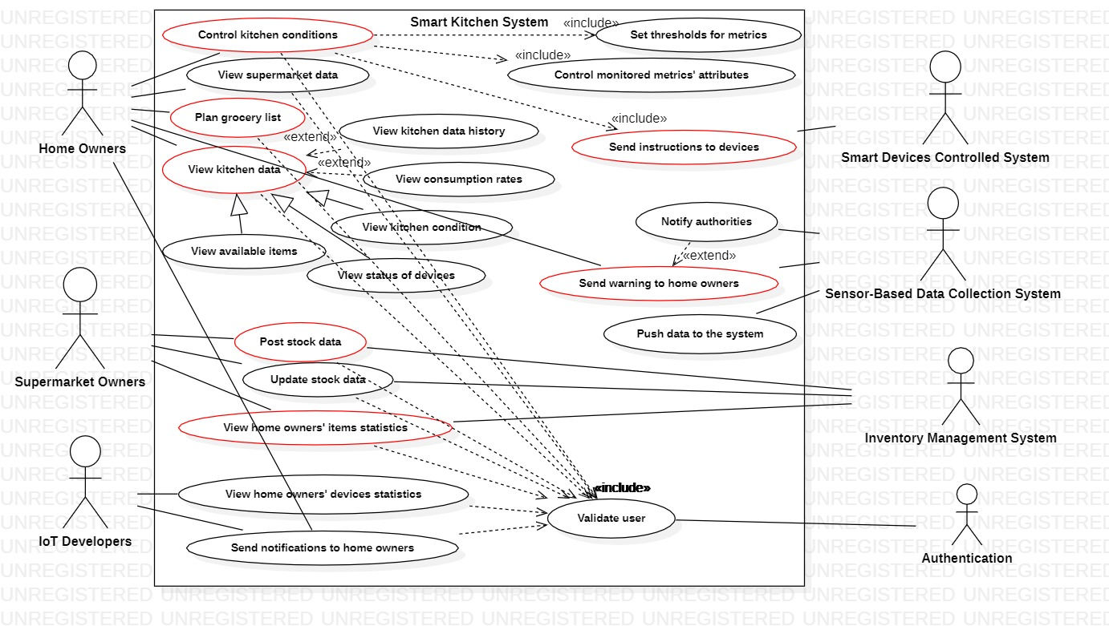
Use Case Diagram

Slide 33
Use Case Description 1
Name | View the kitchen data
Summary | Home owners can view real time data about their kitchens such as available ingredients, consumption rates, status of devices, and kitchen conditions.
Actor | Home Owners
Preconditions | User is validated User is connected to Wi-Fi Sensor-based data collection system is functional
Description | Users open their dashboard and choose the view real time data menu. Users can choose out of the several viewable data, such as status of device, ingredients, consumpution rates, or kitchen conditions.
Alternative Scenarios | Wi-fi connection lost: At any time, system requests User to check their connection to the Wi-fi and restart the system.
Postconditions | Users are able to view the desired data.

Slide 34
Use Case Description 2
Name | Send instructions to devices
Summary | Home owners can view data regarding their kitchen devices, such as their energy consumption or status of the device, and send some instruction to the device, such as turning it on/off, reducing its energy usage, increasing the time (such as cooking time) etc.
Actor | Home Owners Smart devices controlled system
Preconditions | User is validated User is connected to Wi-Fi Smart devices controlled system is functional
Description | User opens their dashboard and chooses the control kitchen conditions menu. Users get a view of their kitchen devices and their status. Users can choose an device to view their data. Users get a list of the available instructions for the selected Instruction is sent to the device which then executes it
Alternative Scenarios | Wi-fi connection lost: At any time, system requests user to check their connection to the Wi-fi and restart the system.
Postconditions | The user’s selected device executes the desired instruction the user chose

Slide 35
Use Case Description 3
Name | Plan grocery list
Summary | Home owners can plan their grocery list using various information available from their dashboard
Actor | Home Owners
Preconditions | User is validated User is connected to Wi-Fi Sensor-based data collection system is functional
Description | User uses his dashboard to view list of available items in the kitchen User searches dashboard for items he needs and their prices based on posted supermarket offers User uses this data to plan his grocery list accordingly
Alternative Scenarios | Real time list of supermarket offers is not available: System sends notification to supermarket owners informing them.
Postconditions | User’s creates a grocery list to use for when they go grocery shopping

Slide 36
Use Case Description 4
Name | Send warning if some metric exceeded the preset threshold
Summary | Sensor-based data collection system checks collected data against set thresholds and sends a warning if thresholds are exceeded
Actor | Sensor-based data collection system Home owners
Preconditions | Sensor-based data collection system is connected to Wi-Fi Sensor-based data collection system is functional
Description | Sensor-based data collection collects real-time data on a number of metrics System checks this data against existing thresholds If threshold is exceeded, a warning is sent to the appropriate parties
Alternative Scenarios | Data exceeds thresholds and reaches dangerous levels: System automatically notifies authorities about this emergency
Postconditions | Metrics are kept within appropriate levels, and users have a quick response system available in case metrics exceed thresholds.

Slide 37
Use Case Description 5
Name | Post data about stock
Summary | Supermarket owners post information about their stock on the system for home owners to view.
Actor | Supermarket Owners Inventory management system
Preconditions | Users are validated Users are connected to Wi-Fi Inventory management system is functional
Description | Users open their dashboard and choose to post information on new stock Users connect their inventory management systems to the smart kitchen system
Alternative Scenarios | Inventory Management system could not be connected: System sends an error message to the supermarket owners informing them of the error (if known) and requesting they try reconnecting and restarting the system.
Postconditions | Stock data for supermarket owners is posted on the smart kitchen system and is available for home owners to view

Slide 38
Use Case Description 6
Name | View statistics about items homeowners buy
Summary | Supermarket owners can view data about items home owners have in their kitchens
Actor | Supermarket Owners Inventory management system
Preconditions | User is validated User is connected to Wi-Fi
Description | User opens their dashboard and chooses to view homeowner statistics Users can filter the representation to see the entries they are interested in
Alternative Scenarios | Wi-fi connection lost: At any time, system requests User to check their connection to the Wi-fi and restart the system. User statistics not available: An error message is sent to the supermarket owners, and a notification is sent to the technician of the system informing them of a possible malfunction.
Postconditions | A visual representation of home owner statistics with filters applied is shown to the user

Slide 39
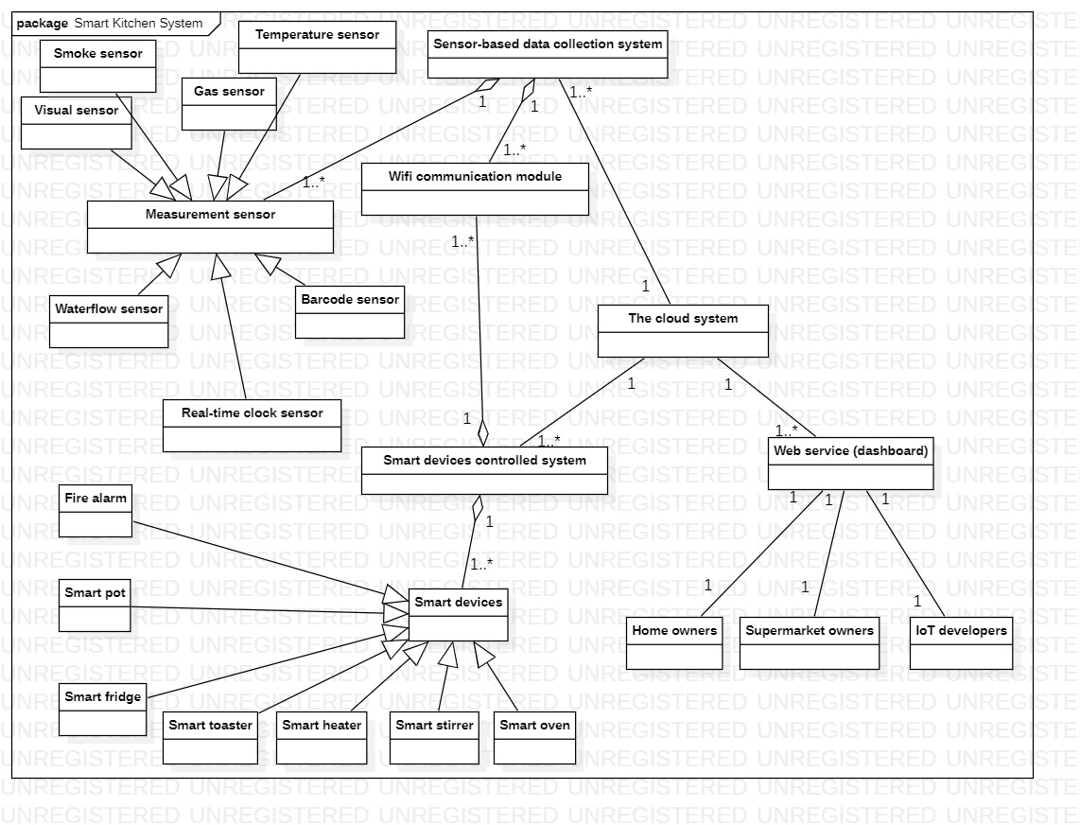
Domain Modeling

Slide 40
Functional Requirements
The system should be able to perform validation and authentication to prevent misconduct.
In order to do (1), the system should be connected and has access to the relevant identity databases.
The system should be connected to Wi-Fi and cloud database.
The system should be able to process data from sensors.
The system should be able to perform measurements.
The system should be able to compare measurement results with certain thresholds.
The system should be able to record, display, and process the stakeholder’s data. This includes statistical analysis and visualization.
The system should be able to generate notifications and warnings and give them to users.
The system should be able to receive input from IoT developers and send them as notifications to users.
The system should be connected to relevant authorities, such as policemen, firemen, and healthcare facilities, in order to respond to emergencies.
Notes:
validation/authentication
Access to wifi and databases
Recording data/performing measurements, processing data, and generate appropriate responses such as notifications and warnings
Connect to relevant authorities

Slide 41
Non-Functional Requirements
Usability
Internationalization
Privacy
Reliability
Performance
Safety
Scalability
Security

Slide 42
Usability
Within a week, at least 80% of all users should be able to use the system to fulfill their desired needs
The web interface elements (e.g. login, video display page) will be simple & easy to understand conveying only the necessary content
All content will be easily reachable via appropriate links. Content should be accessed from anywhere
Users can flexibly traverse the system and perform actions in whatever order they require
System will, at all times, clearly make visible it’s current status
Errors will not exceed 1 bug per 1000 lines of code
Error messages must give the user specific instructions for recovery and must speak the user’s language
Follow standards and conventions when designing the interface
Use terminology that users understand
Add a help page and complete user documentation which will explain how to achieve common tasks
Add special commands and accelerators to increase the efficiency of experienced users. Efficiency increase should be roughly 50% compared to the average
Notes:
80% of users within a week
Simple and easy to understand
Flexible
Accelerators for expert users

Slide 43
Internationalization
Adapt interface text and messages to the user’s language
Adapt system related documents to the user’s language
Adapt icons, maps, and colors to fit the user’s culture avoiding offending signs.
Allow users to display, input, store, and print characters from their native languages
Classify and sort characters according to users’ native languages rules
Use typesetting rules appropriate for the users’ native languages
Use Unicode (UTF-8) to encode all scripts and symbols in the system
Use globalization management systems to help manage all the different global versions
Use page format that works with both A4 and 8.5x11
Use user’s currency, date and time format, measurement units, and address formats in all content information (documents and interface)
Implement user’s currency, date and time format, measurement units, and address formats in the code
Adapt cooking devices and utensils functions to the user’s culture (for example Asian cultures usually use chopsticks as utensils whereas non-Asian cultures don’t as much)
Allow users to save file names using characters from their native languages
Notes:
Translate text, names and messages.
Use formats from user culture
Adapt functionalities to user’s culture
Use Unicode (UTF-8)

Slide 44
Privacy
Ensure proper accountability is maintained for all personal info collected from the user
System should limit information collection to just the necessary information
For each information collected, identify the purpose of the information and get consent to collect the information
Ensure that the info is not reused or disclosed anywhere else outside the system
Retain the information for only as long as necessary
Ensure that all the collected information is accurate, complete, and up to date
Protect information with appropriate security safeguards
Make privacy and data collection policies and practices public and easily available to the user
Allow users access to their information at will
Data protection options will be added to the Internet architecture
Protocols will be developed to automatically negotiate privacy requirements
Use a digital rights management system for managing personal information
Use W3C’s Platform for Privacy Preferences Project to ensure and assure users that their privacy standards are being met.
Notes:
Limit information collection
Ensure information is safeguarded and not reused or disclosed
Ensure accuracy of information
Use W3C privacy preferences project standards

Slide 45
Reliability
Devices should be plugged in at all times
Web interface should be 100% percent available at least 165 hours per week
If the web interface crashes, it must be repaired in at most 30 minutes
Devices work perfectly until their life time expires
External services are at least 95% reliable every week

Slide 46
Performance
System should work real-time which means there should be an acceptable time delay such as max 4-5 seconds between request and response.
Wi-Fi adapter needs to be fast enough to transfer data almost real-time
Web server should be able to handle multiple device and user connection simultaneously. Web server may initially handle roughly 100-1000 users which could be scaled if the need arises

Slide 47
Safety
In case of malfunction, system should shutdown itself and reboot in order to prevent unpredicted results.
System should not let important functions such as smoke detectors be turned off by users
If device is malfunctioning, shutdown immediately and reboot in order to prevent disastrous results

Slide 48
Scalability
Ensure that the database used has the capacity for the potential growth
Ensure that the system can handle potential growth in user’s kitchen items and devices
Check capacity requirements with host to ensure server scalability

Slide 49
Security
Multi-level access for users (admins, users, supermarket owners, IoT developers)
Password login for each dashboard (users, supermarket owners, IoT developers)
Secure and private access for each user to to their kitchen systems
System should store user data on database securely and set access permissions to the these datas carefully

Slide 50
PROTOTYPE

Slide 51
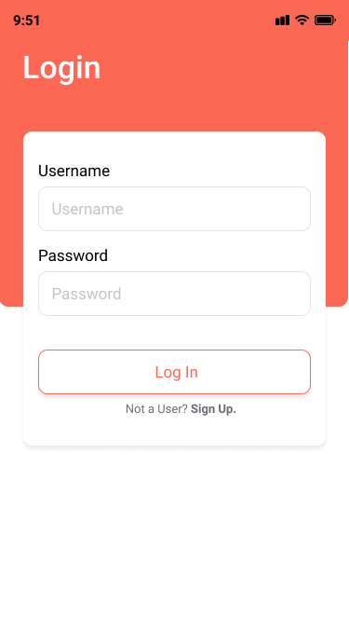
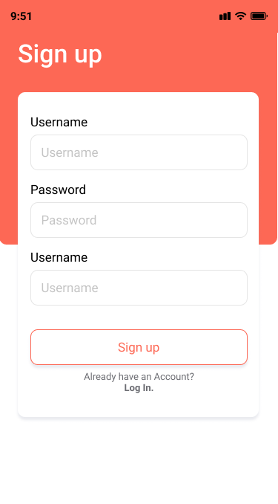
Log in/Sign up
Login for returning users.
Redirects to sign up page if sign up is chosen.
Redirects to homepage of the returning user if user logged in successfully.
Create a new account for users.
Redirects back to log in page after a new user successfully creates an account.

Slide 52
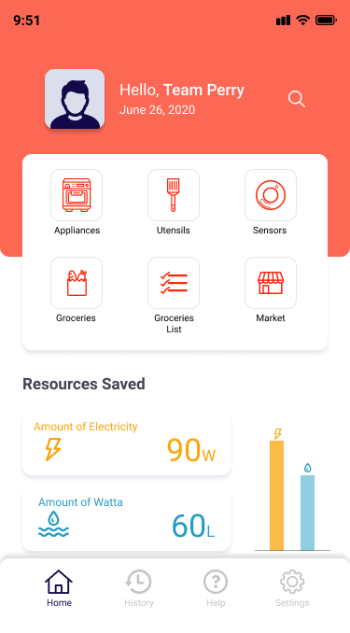
Homepage
See current date and user account info.
Lists all available features such as history, appliances, utensils, groceries, emergency calls, sensors, grocery list, market, and settings.
Navigate to all other features
See amount of resources saved.

Slide 53
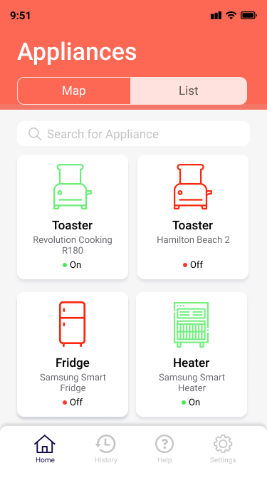
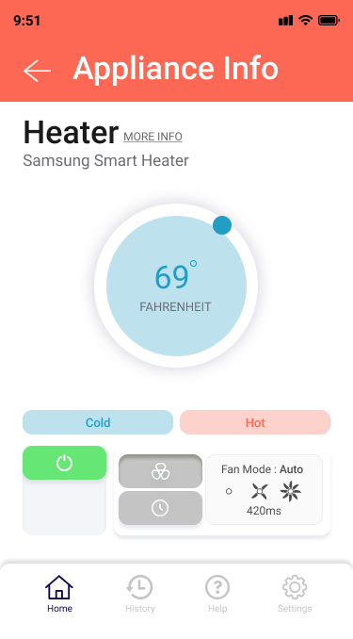
Appliances Feature
Lists appliances in the kitchen and change their status.
Displays the kitchen appliances in the form of a map according to its real time position in the kitchen.
Redirects users to the chosen appliance's info page in order to change its status.
See more information of the appliance.
Change the appliance's status.

Slide 54
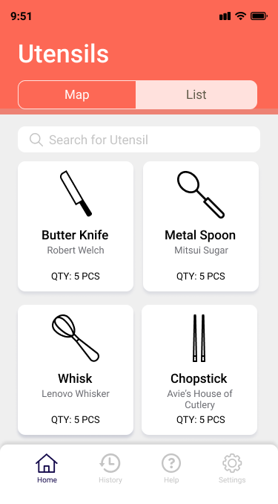
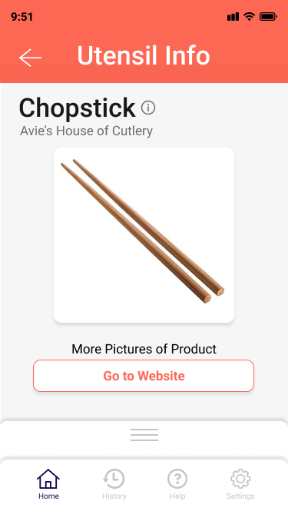
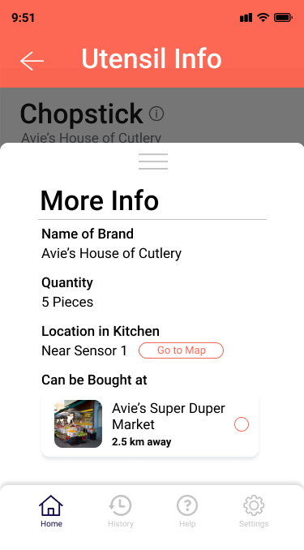
Utensils Feature
Lists utilities in the kitchen
Displays the available utensils in the form of a map according to its real time position in the kitchen.
Redirects users to the chosen utensil's info page in order to change its status.
See more information of the utensil.
Redirects users to the market page where users can see markets that sell the item.

Slide 55
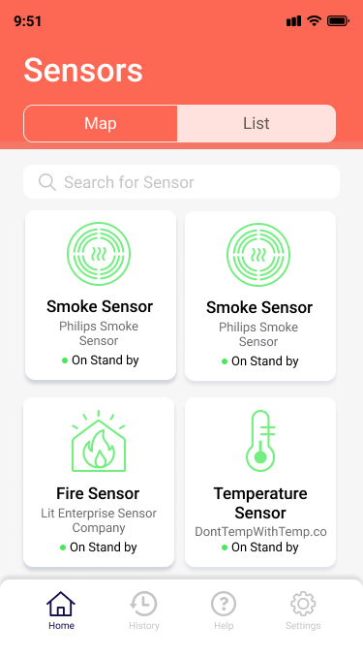
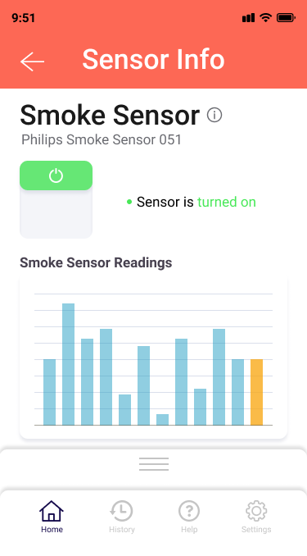
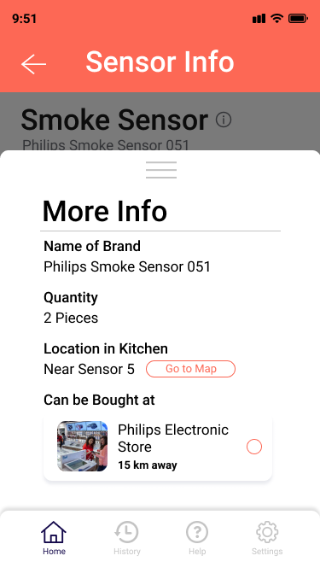
Sensors Feature
Lists all the sensors in the kitchen
Displays the available sensors in the form of a map according to its real time position in the kitchen.
Redirects users to the chosen sensor’s info page in order to change its status.
See more information of the sensor.
Redirects users to the market page where users can see markets that sell the item.

Slide 56
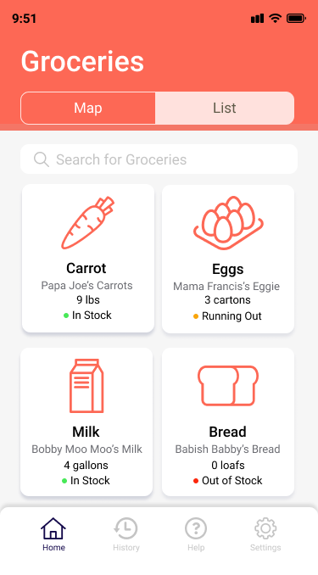
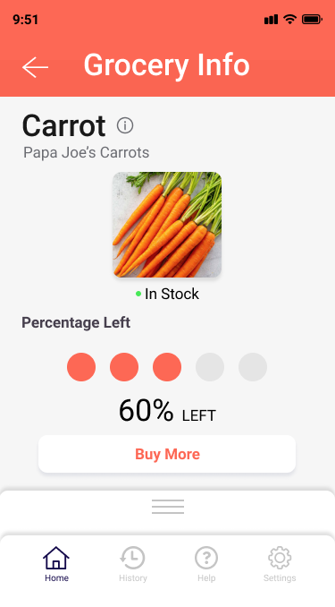
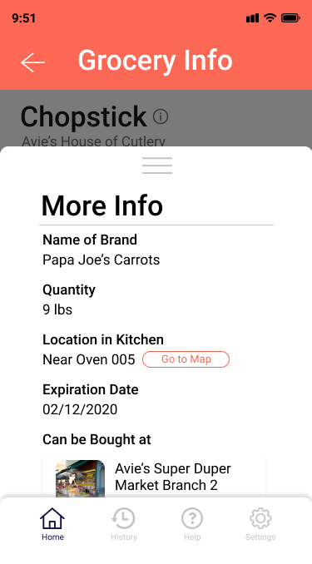
Groceries Feature
Lists groceries available in the user's kitchen.
See more information on the grocery item, such as the amount, expiry date, the name and brand.
Redirects users to the market page where the users can see what markets sell the grocery item.
Redirects users to market page when choosing the market to buy the grocery item from.

Slide 57
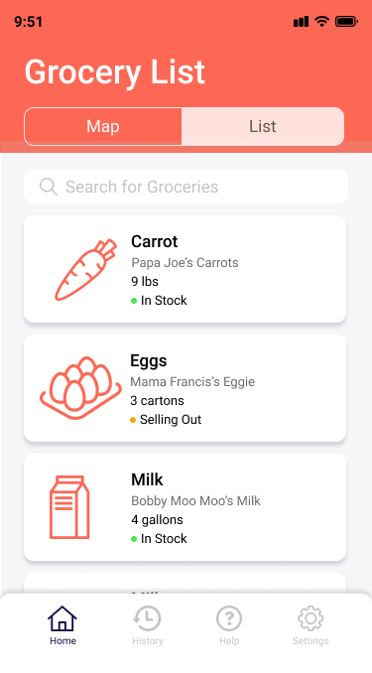
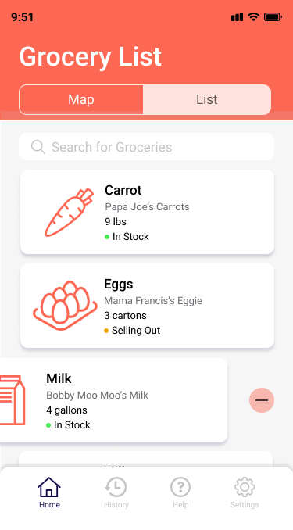
Grocery List Feature
Help users plan their grocery list
Buy the designated items

Slide 58
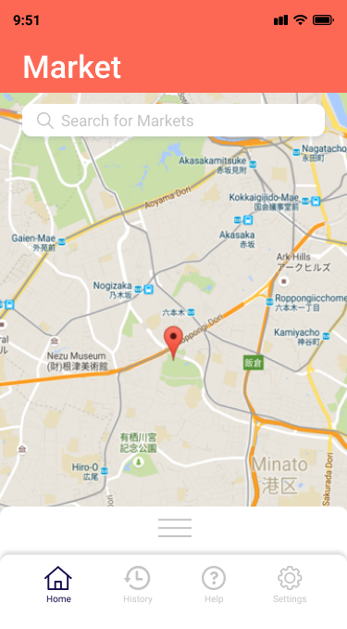
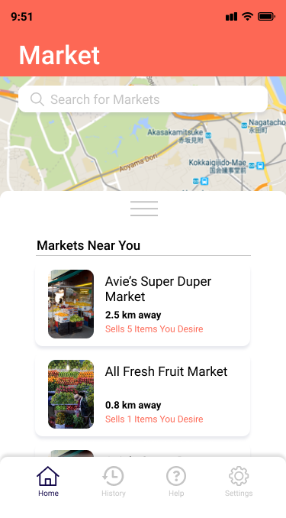
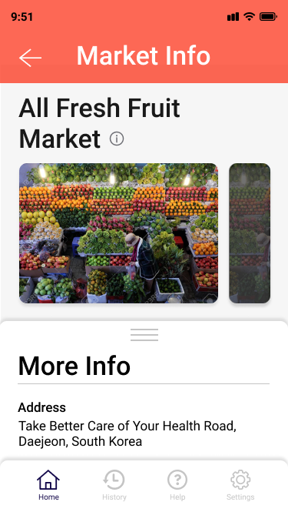
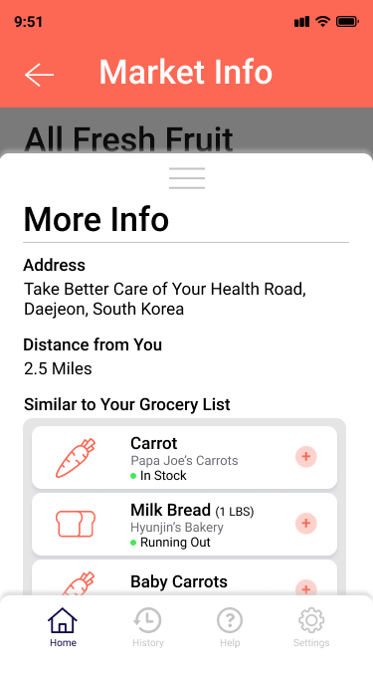
Market Feature
Displays markets near the users and the items they sell.
Allows users to search for markets that sell a specific item.
Redirects users to market's info page.
Users are able to choose an item they want to buy from a market and add them to the "Grocery List"

Slide 59
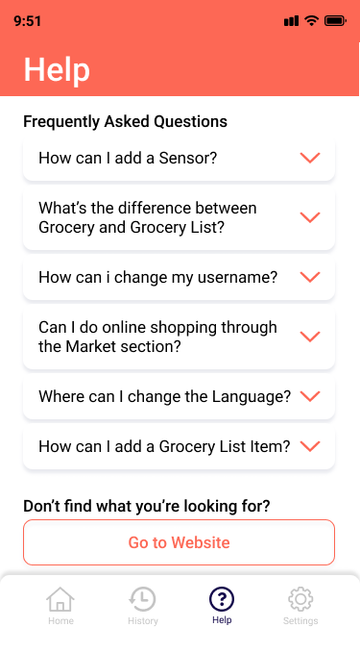
Help Page
Lists the ways users can use the application.
Redirects the user to the help website page if no information could be found on the app.

Slide 60
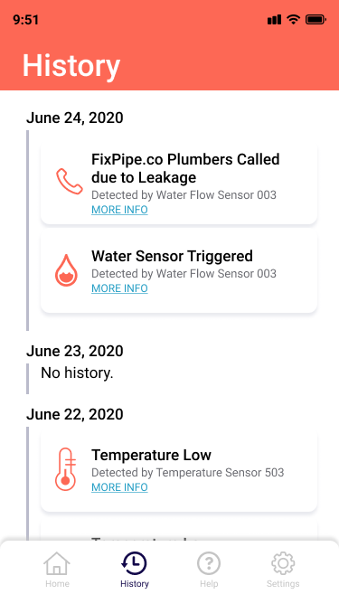
History Feature
Check the history of activities done by in the app.

Slide 61
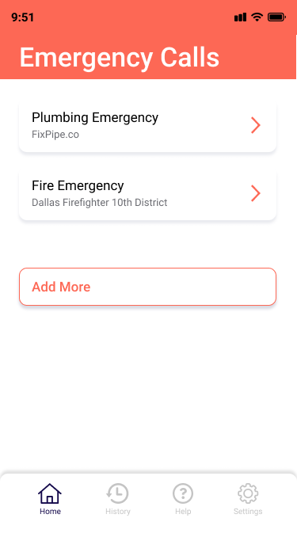
Emergency Calls Feature
Lists the emergency personal the app will contact in case of emergencies.
The user can edit or add the emergency personal that will be contacted by the app.

Slide 62
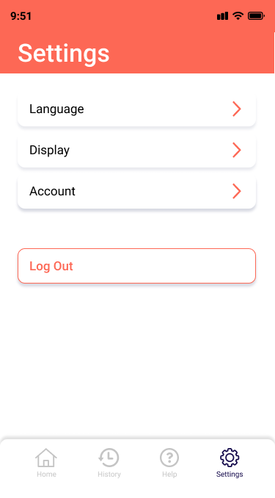
Settings Page
Log out of current user's account.
Edit account information of the current account such as the username, password, or confirmed email.
Change the display settings of the application. The display settings consist of font size and light/dark theme.
Change the language of the application.
Redirects users to account settings page to see more account settings.
Redirects users to display settings page to customize the user's interface.
Redirects users to a list of languages available if language is settings is selected.

Slide 63
Prototype link:
https://marvelapp.com/prototype/5ac20ad/screen/70598153

Slide 64
LESSONS LEARNED

Slide 65
Lessons Learned.
We learned how to design a system from the user’s perspective. Users are not the same as us, so it is important to align our views with those of users.
We learned various methods of requirements elicitation: how to conduct them, their strengths and weaknesses, and how to interpret their results. We saw how they could be used to elicit requirements from users.
We learned how to make flow, sequence, artifact, cultural, and physical diagrams, as well as how to consolidate them. We realized that they help us visualize abstract workflows in users’ daily activities.
After that, we learned how these diagrams help us make storyboards, vision diagrams, and user environment design.
We learned how to prioritize requirements according to their level of criticality, effort required, and risk involved.
We learned how to make a prototype based on our requirements elicitation results.
We learned how to generate SRS documents to describe our system

Slide 66

THANK YOU.
ANY QUESTIONS?

